Slide 1
Introduction to Heavy-Ion Physics
Coleridge Faraday
University of Cape Town, South Africa
SA-CERN Trip to University of Venda
frdcol002@myuct.ac.za

Slide 2
Introduction

Slide 3
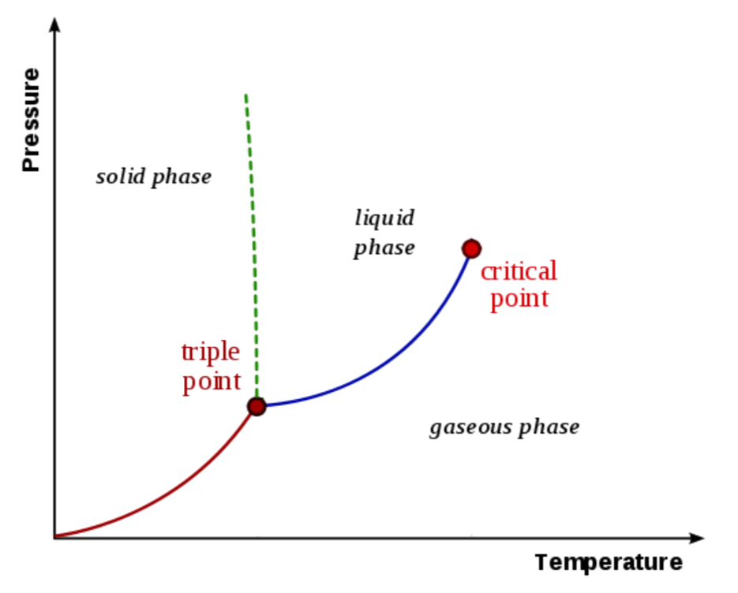
Capturing Many-Body Physics
Phase Diagram of Water
Notes:
Under different conditions, matter can have radically different properties, and we’d like to represent that visually using a phase diagram. What are some properties we associate with various phases of matter? Solid, liquid, gas. Note that the lines correspond to first order phase transitions: a rapid change from one state to another. Under our everyday conditions, water is either a solid, liquid, or gas, and it’s a solid until it’s liquid. After the critical point, the phase transition becomes a crossover. E.g. butter.

Slide 4
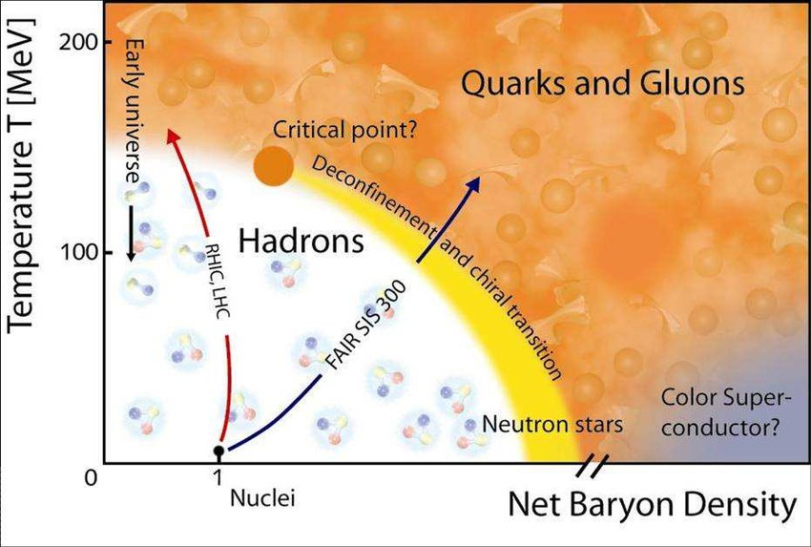
What are We Studying?
The emergent, many body properties of nuclear matter (quarks and gluons)
Notes:
We’ll review these ideas in reverse order

Slide 5
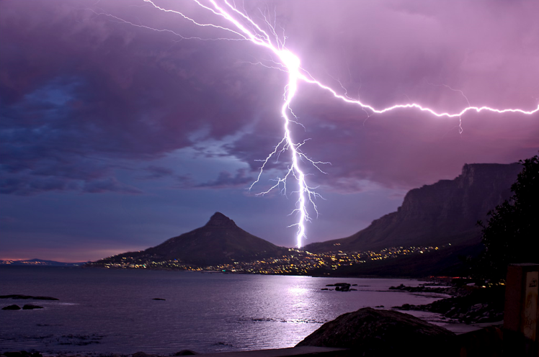
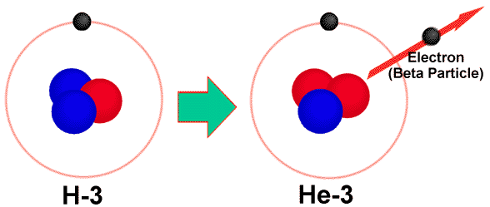
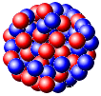
What does that mean? Forces
Gravity
Electromagnetism
starchild.gsfc.nasa.gov
John Maarschalk, travelblog.portfoliocollection.com
Weak
Strong
lhs.lps.org/staff/sputnam/chem_notes/tritium_decay.gif

Slide 6
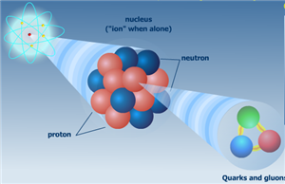
Zoom in on the Nucleus
Nuclei made up of protons and neutrons
p, n made up of quarks and gluons
Analogous to electrons and photons
Confined to p, n under normal conditions
nobelprize.org
Notes:
Nobel prize for asymptotic freedom. Confined for strong force; cf electromagnetic force for which we see the charges (electrons) and the force carriers (photons)

Slide 7
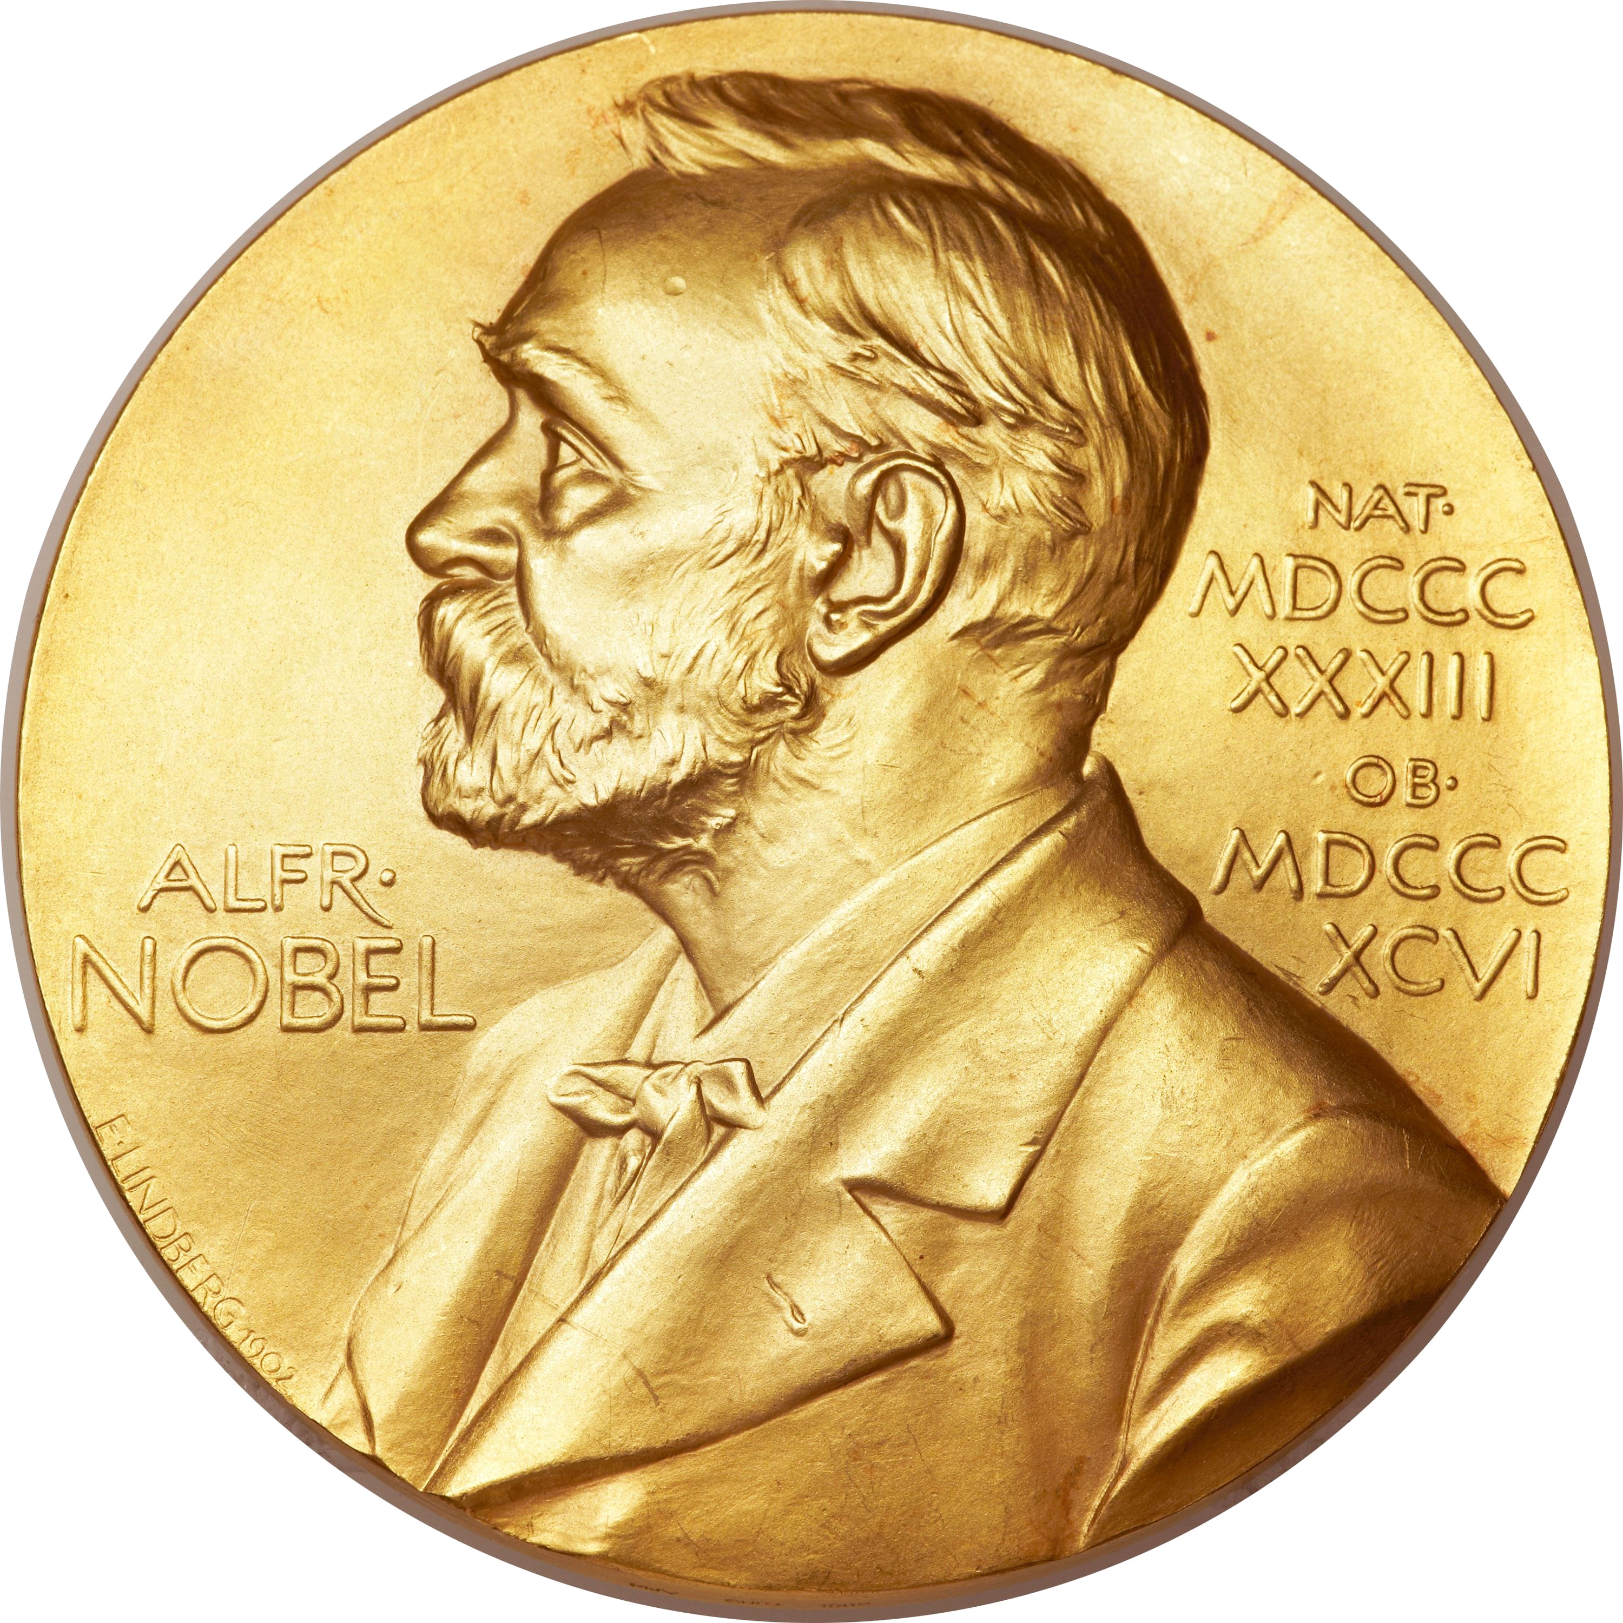
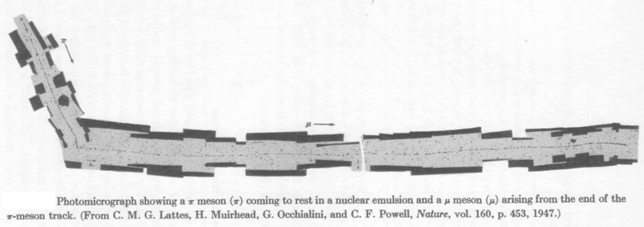
Strong Force
Described by quantum chromodynamics (QCD)
Extremely complicated, even today
Conservatively, 9 years’ of Nobel Prizes
Clay $1M Prize: prove ∃ mass gap
Notes:
QCD: three colors; only observe color neutral (white) objects like protons, neutrons, pions. Why?
14 Nobel Prizes in total
Fundamental unknown questions: mass gap, confinement, chiral symmetry breaking; proton mass

Slide 8
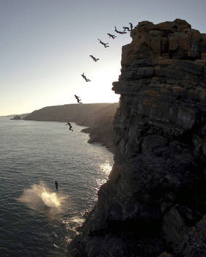
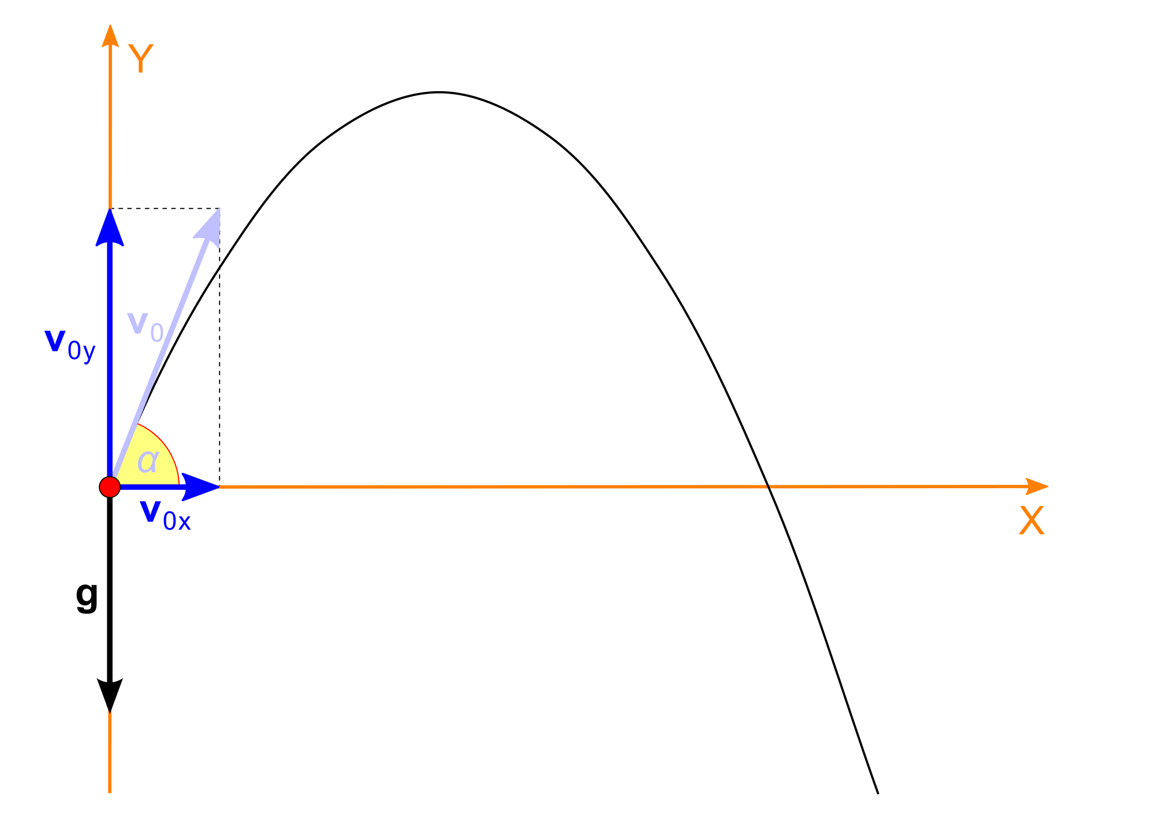
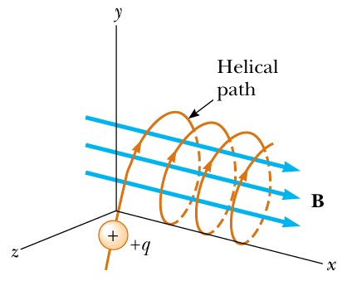
One vs Many
Much of physics is particle physics
What is the motion of a single object?
Notes:
Projectile motion; parabolic, t^2 motion of a cliff diver; an electrically charged particle in a magnetic field

Slide 9
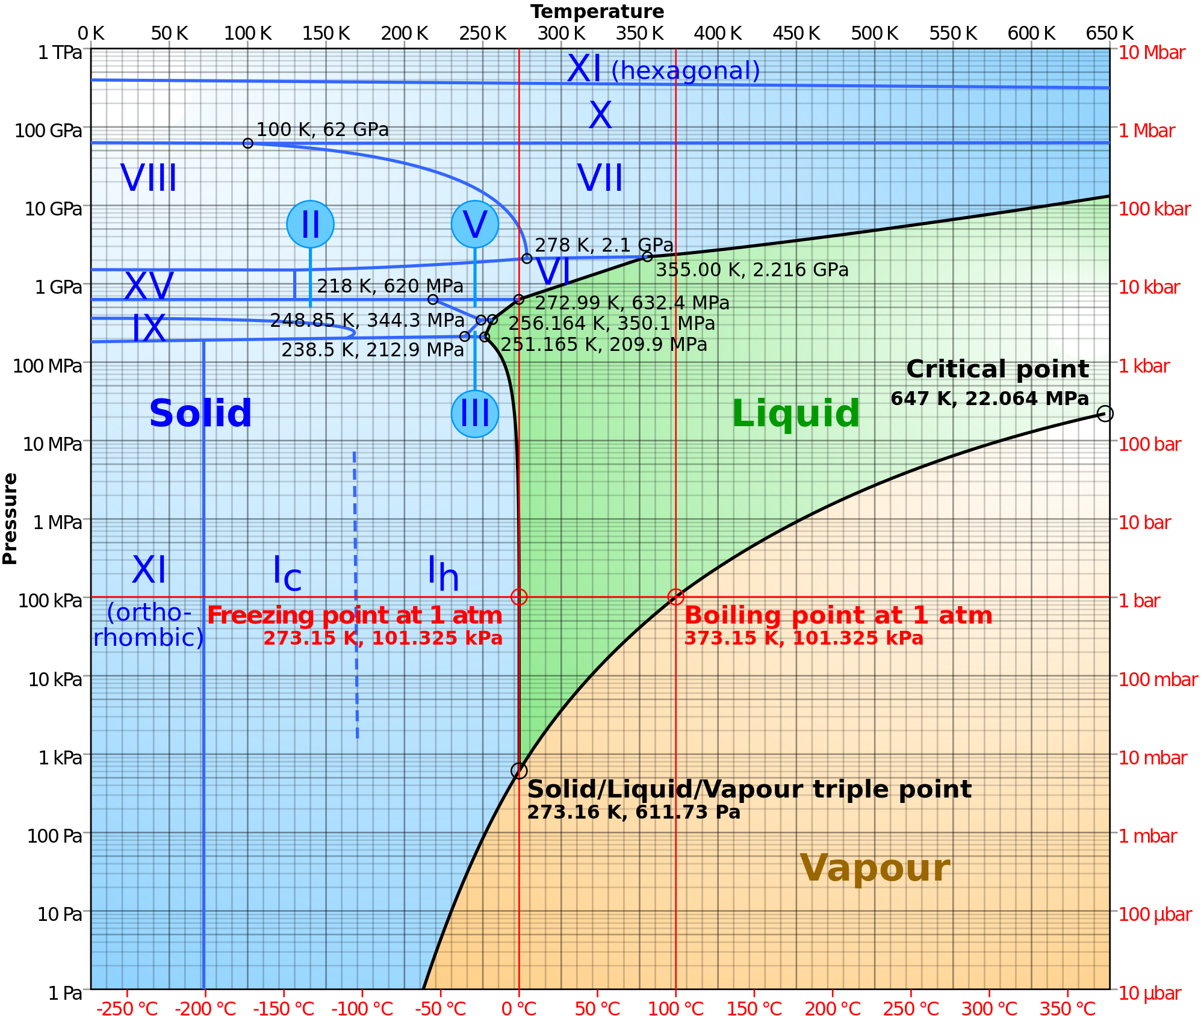
Many Body Behaviour
How does Maxwell equations + quantum mechanics lead to, e.g., water?
One H₂0 is very boring
Vibrates, rotates
Extremely well understood
Lots of H₂0 is very interesting
http://howyourbrainworks.net/content/
neutral-polar-and-electrically-charged-
particles
http://en.wikipedia.org/wiki/Phase_diagram
Notes:
Fundamental rules of the game are known and fixed. How does having a lot of stuff lead to complex dynamics one cannot easily predict from those simple fundamental rules?

Slide 10
Emergent Phenomena
Many particles together can have collective behavior
Pressure, temperature, compressibility, waves
Notes:
Profoundly affects not only the questions we can ask, but also whether we can even answer those questions. For example, we won’t be able to answer the question: what will the temperature be on July 25, 2019 like we can for July 25, 2018. But we will have a good idea of the range of values.

Slide 11
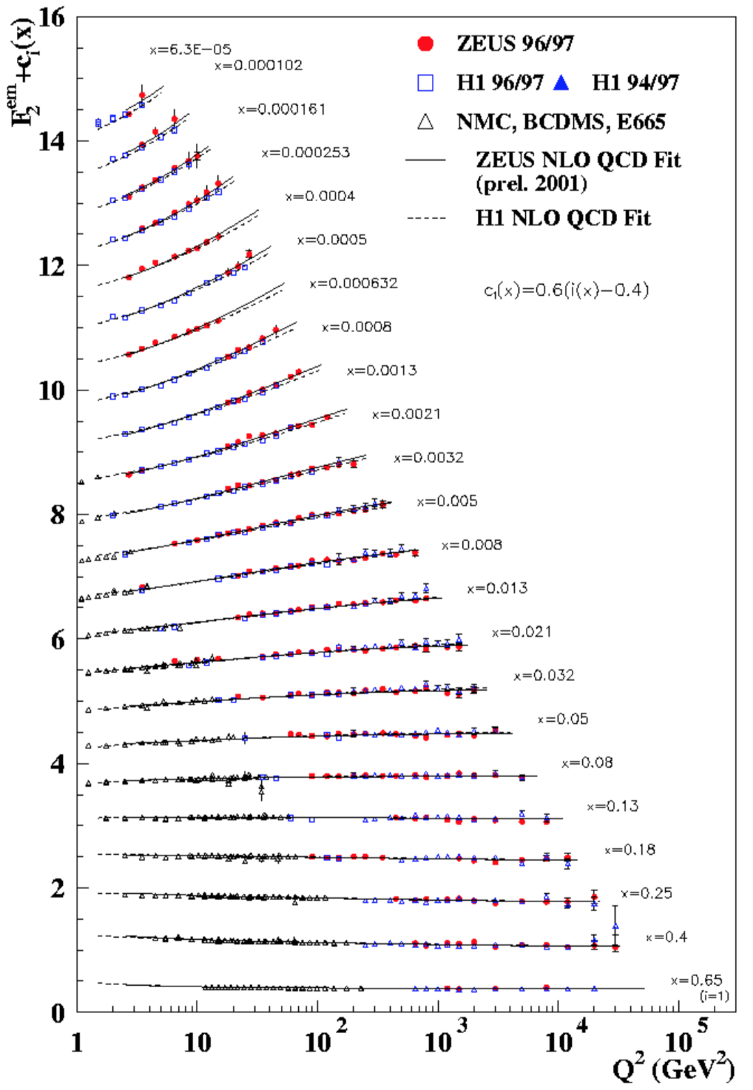
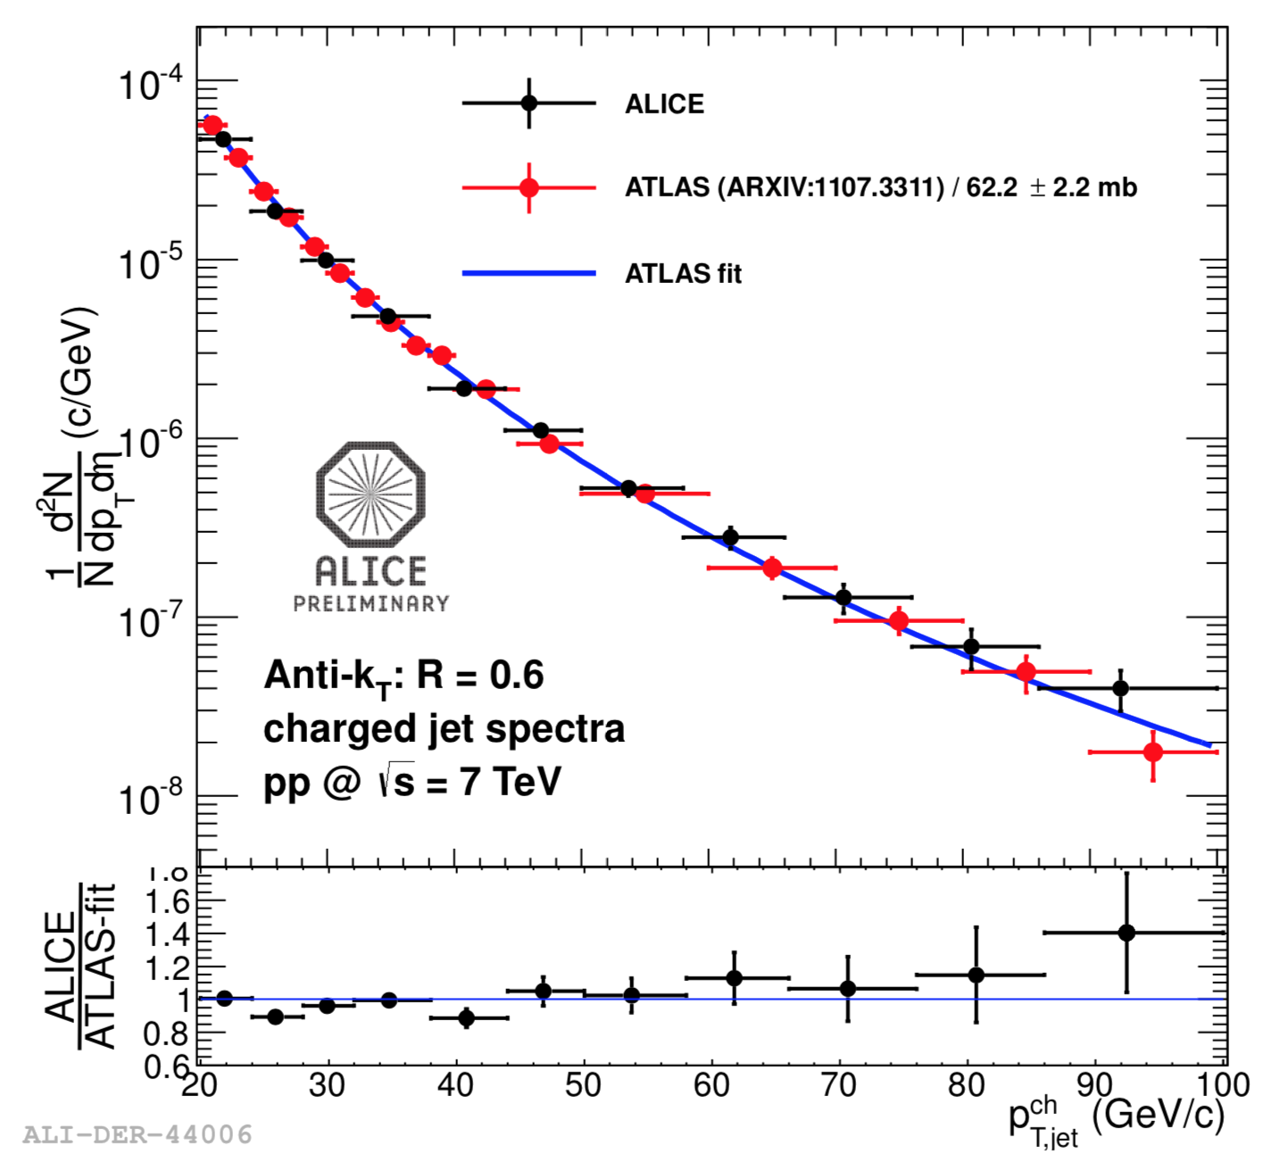
Much of QCD Particle Physics Understood
e+p Collisions
p+p Collisions
Notes:
Like a single H20 molecule, much of the physics of small amounts of QCD matter is well understood

Slide 12
Phase Diagram of Nuclear Matter
Lots of question marks!
Notes:
What happens if we stick a lot of QCD matter together. What emergent properties do we see? Introduce name of quark-gluon plasma.
What are the properties of a large amount of nuclear matter in extreme conditions?
Pressure, energy, entropy, speed of sound, viscosity, heat capacity, …
Phase transition: first order? crossover?
Ice to liquid water vs. melting butter
How much stuff is needed for us to see emergent phenomena?

Slide 13
Motivation

Slide 14
WHY? Basic Curiosity
Desire to know:
What are the unchanging physical laws of the matter that surrounds us?
Notes:
A lot of time & money spent; why bother? Let’s measure and record for the rest of time the fundamental properties of some of the matter around us

Slide 15
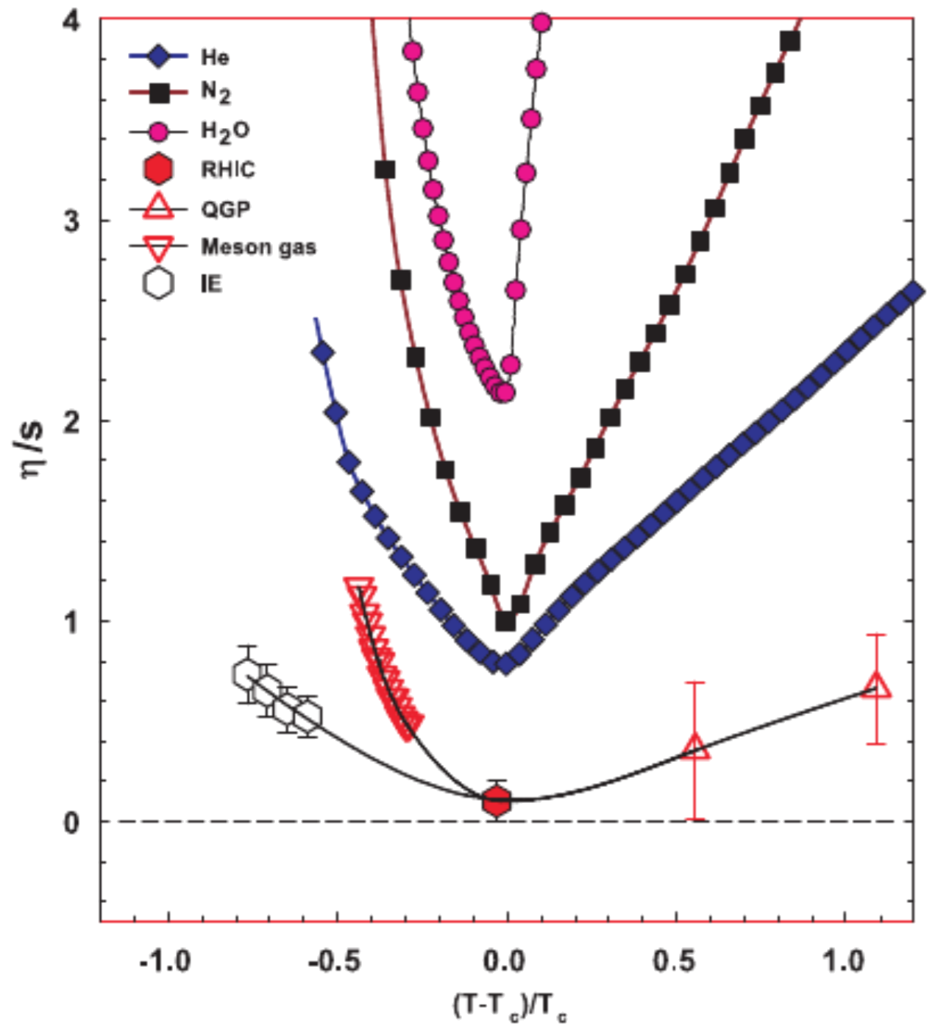
WHY? Seek Perfection
Is there a most perfect liquid?
Fundamental, (quantum?) lower bound?
Is it 1/4π?
Due to black hole entropy in 5D?
Is it due to Heisenberg Uncertainty?

Slide 16
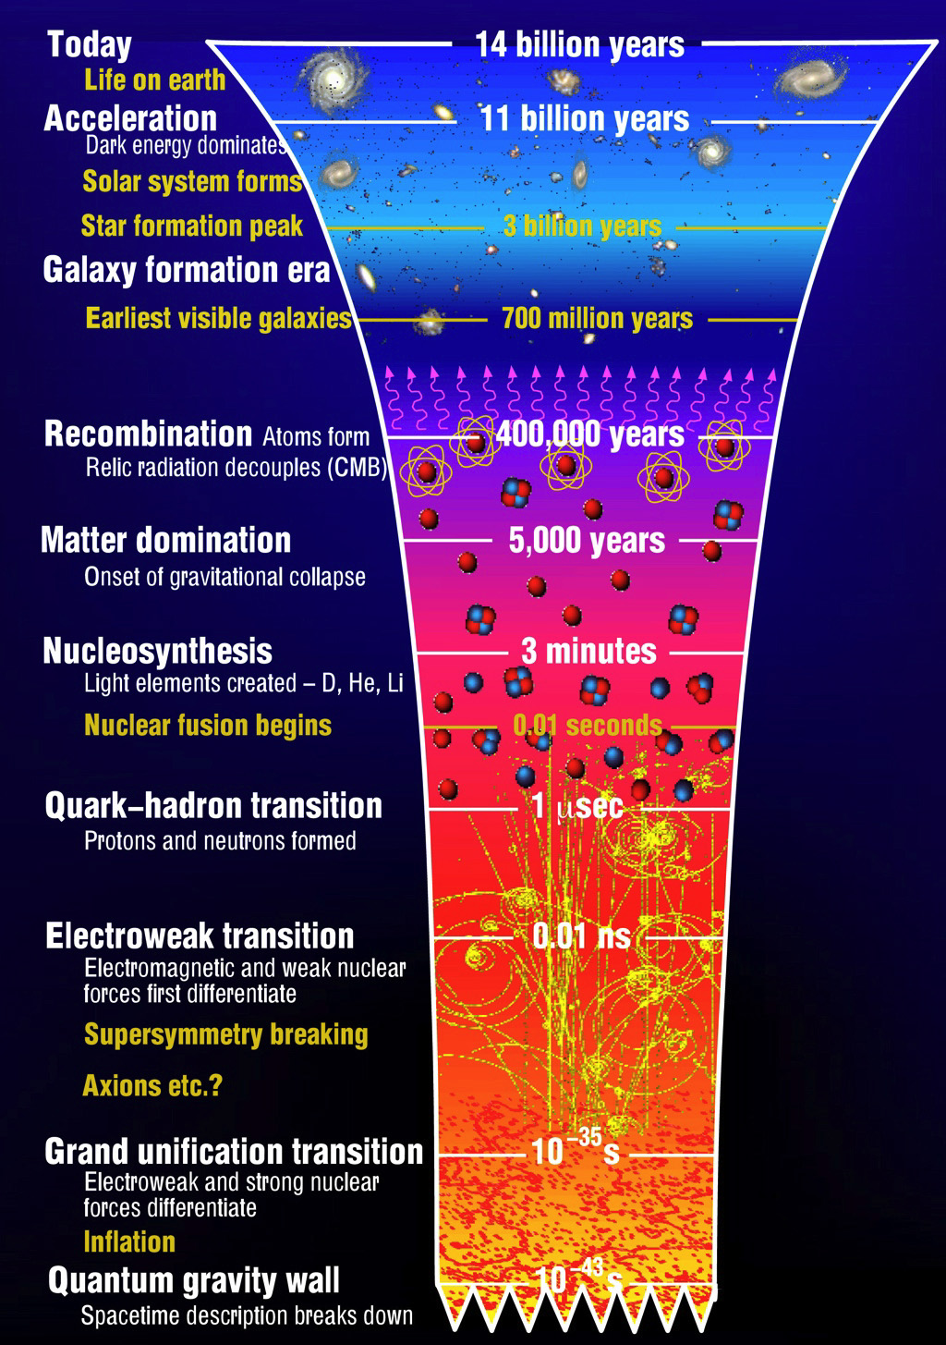
WHY? Early Universe
Turn up the heat, turn back the clock
Physics of a trillion degrees
→
Physics a micro-second after the Big Bang

Slide 17
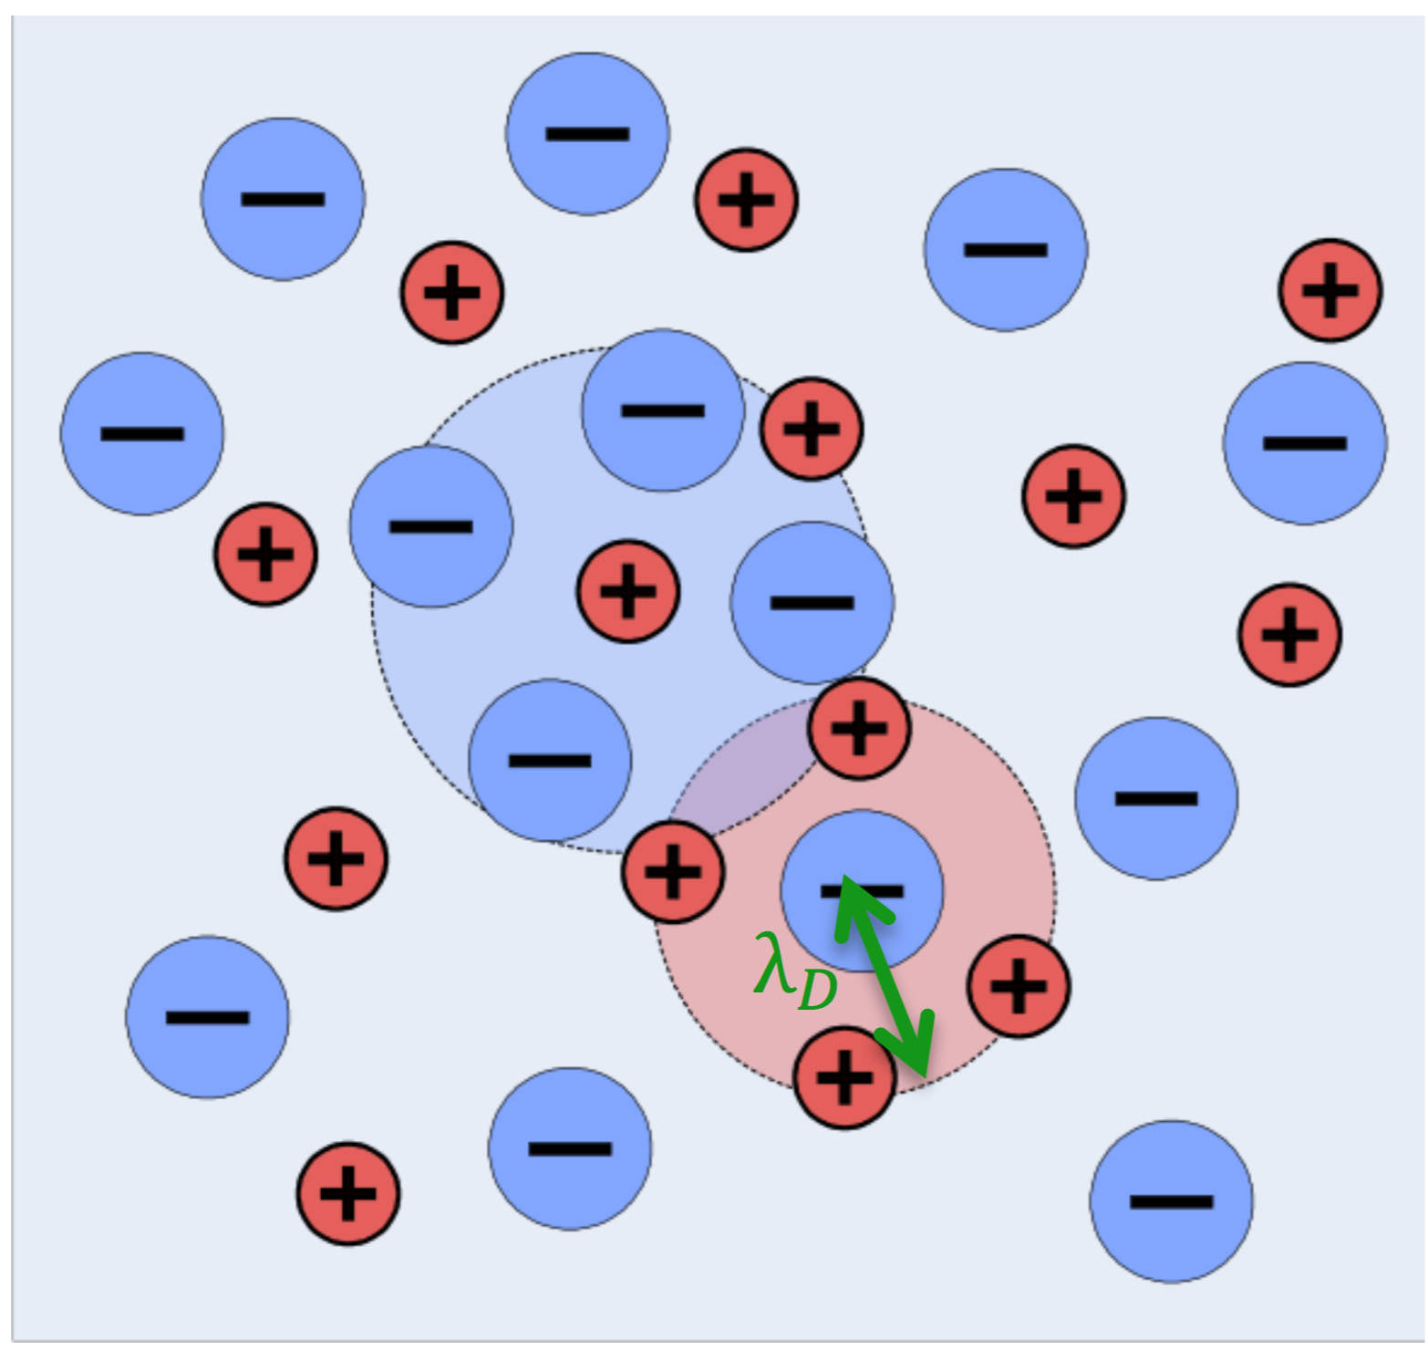
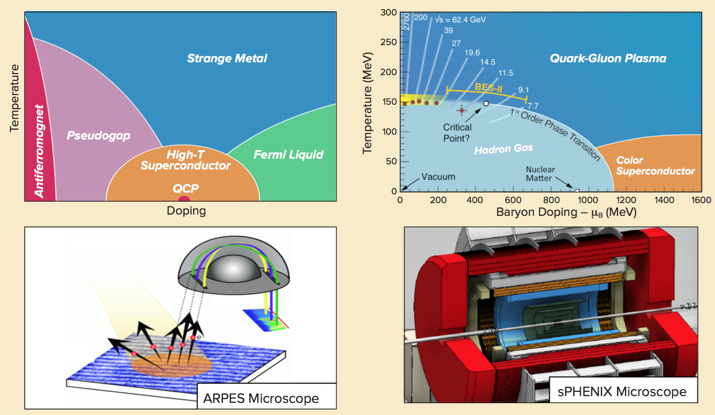
WHY? Connections to Plasma/CM
Does quark-gluon plasma organize itself like a weakly-coupled gas?
Or more like a strongly-coupled fluid?
Debye screening
Notes:
Strongly coupled systems are a major open problem, with likely connections to high T superconductors

Slide 18
Measurement

Slide 19
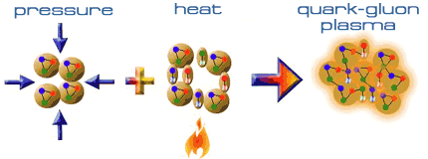
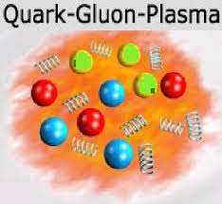
The Quark Gluon Plasma
Hadrons overlap
Quarks roam freely in the medium (deconfinement)
Temperatures of a trillion degrees
https://www.researchgate.net/figure/Illustration-of-quark-gluon-plasma-QGP-comprising-several-red-green-blue-RGB_fig12_280969662

Slide 20
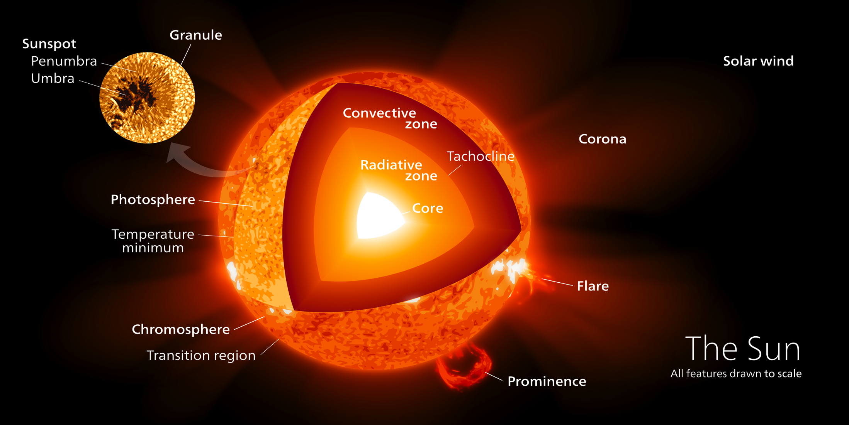
How hot is a trillion degrees?
100,000x hotter than the center of the sun
Notes:
And it only cost $1bn!
Note: surface of sun is 6000K (and that’s what gives us sunburn from 150 million km away). Center of sun is 100 times hotter than the surface of the sun.

Slide 21
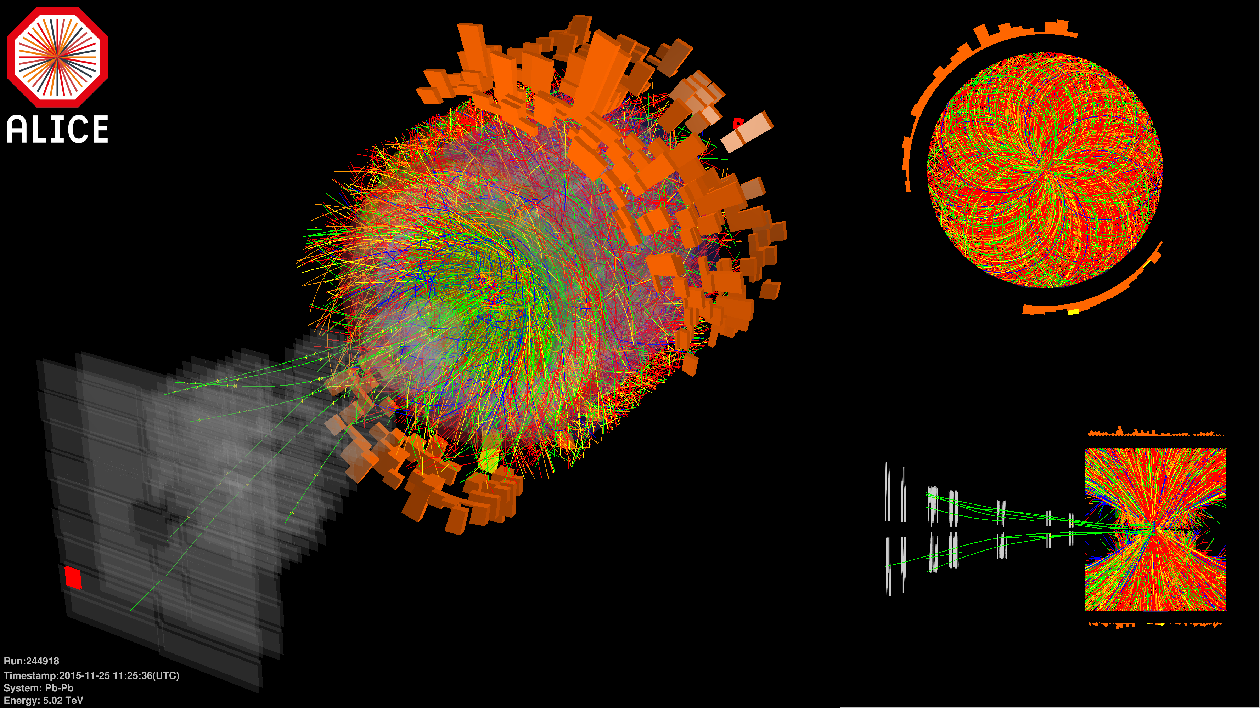
Incredibly Complex Measurements
Notes:
And yet we can extract some useful information!

Slide 22
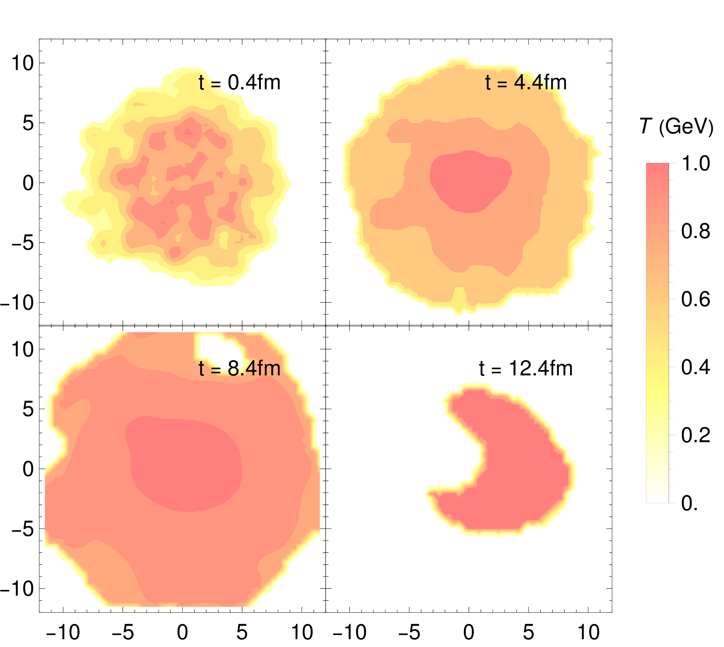
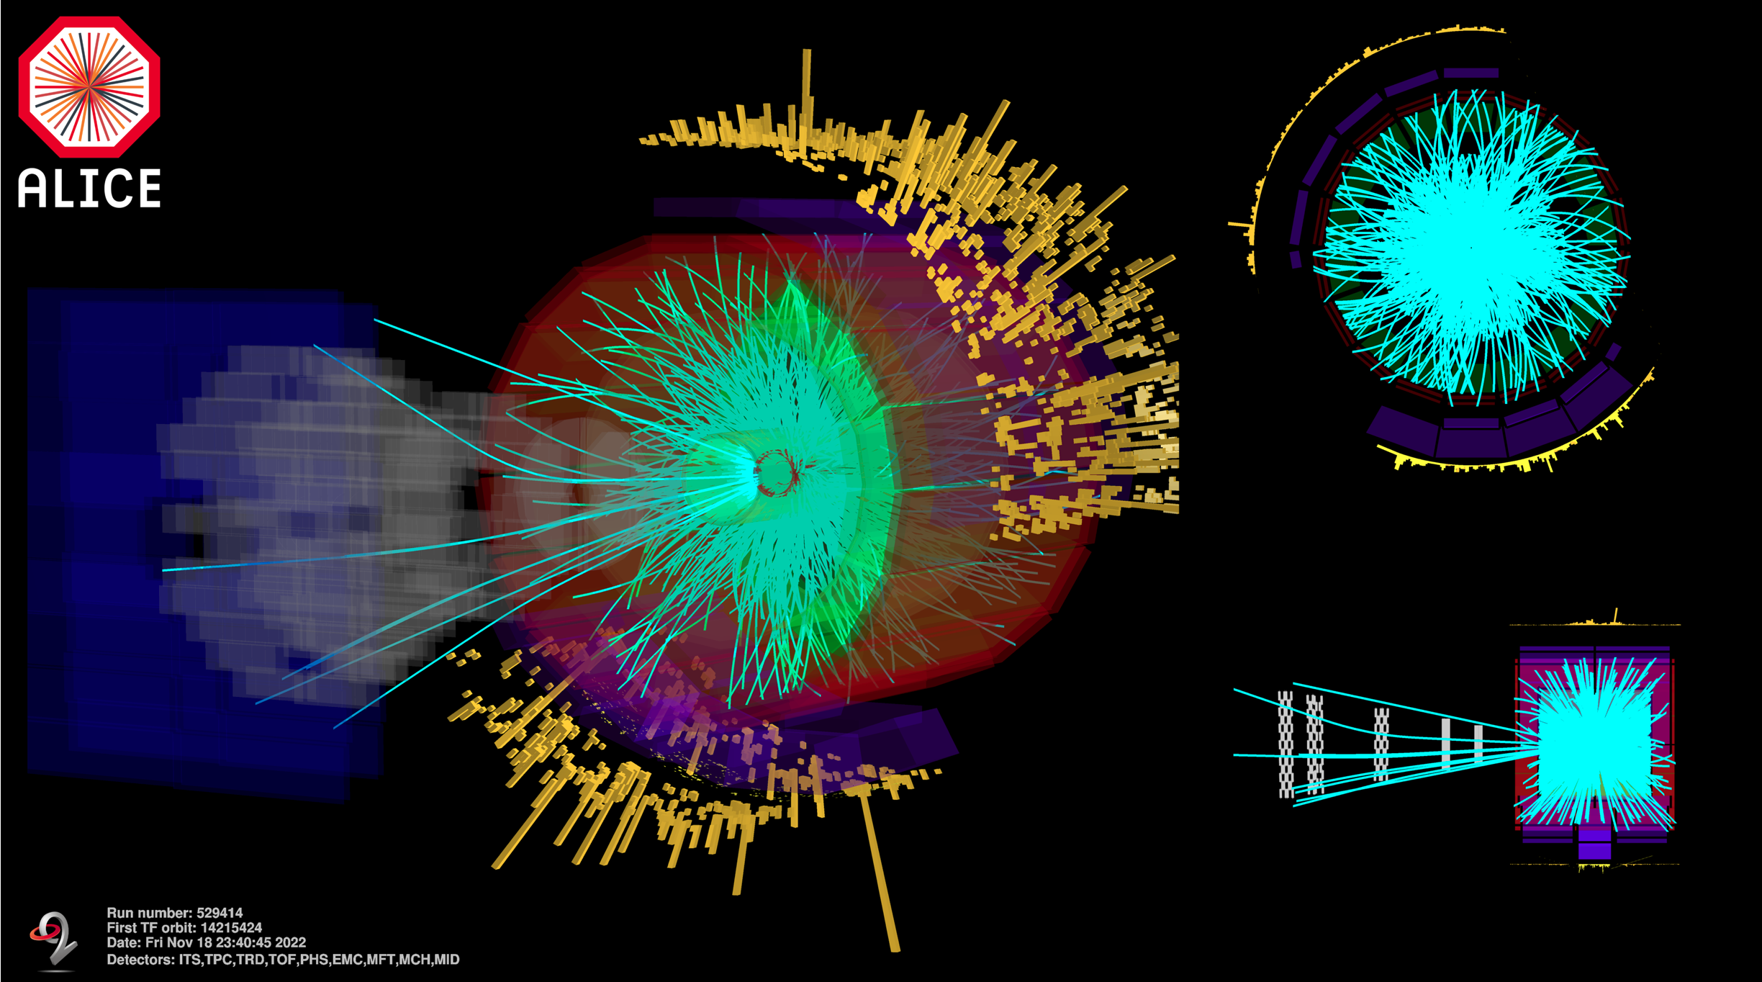
Measuring the Quark Gluon Plasma
QGP in heavy-ion collisions lasts for only ≃ 10⁻²³ s! → difficult to probe
Experiment
Theory
?

Slide 23
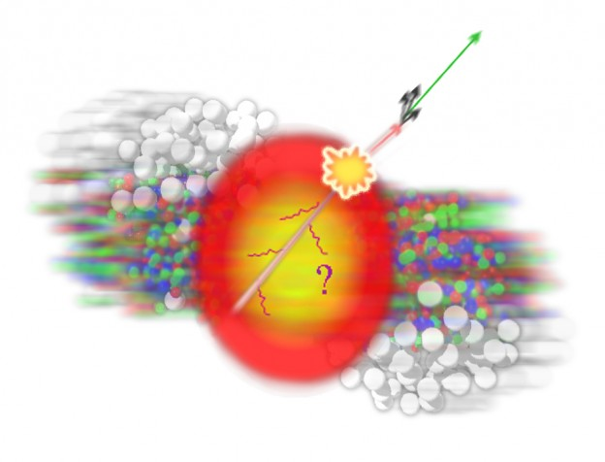
How do we know a QGP is formed?
Look for signatures of QGP formation
How does the QGP effect the properties (momentum, amount, angular direction, etc.) of particles detected in the detector
Signatures of QGP include
Strangeness Enhancement
Collective flow
Jet quenching

Slide 24
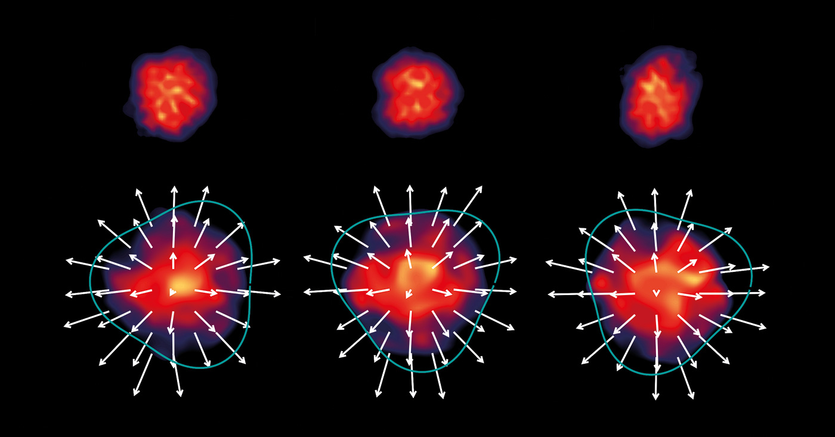
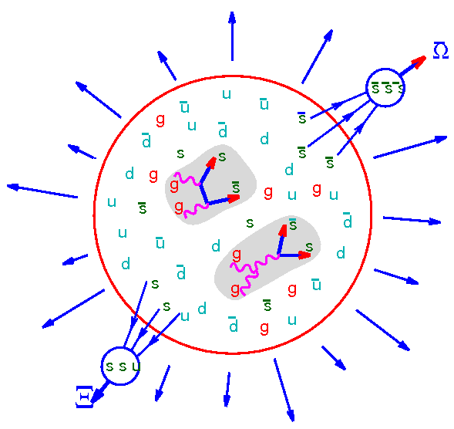
Signatures of the QGP
Jet Quenching
Strangeness Enhancement
Collective Flow
Particles lose energy through interactions in the QGP
Pressure gradients change the distribution of particles
Thermal equilibration leads to higher mass quarks (strange quarks) being produced

Slide 25
Geometry of a Collision

Slide 26
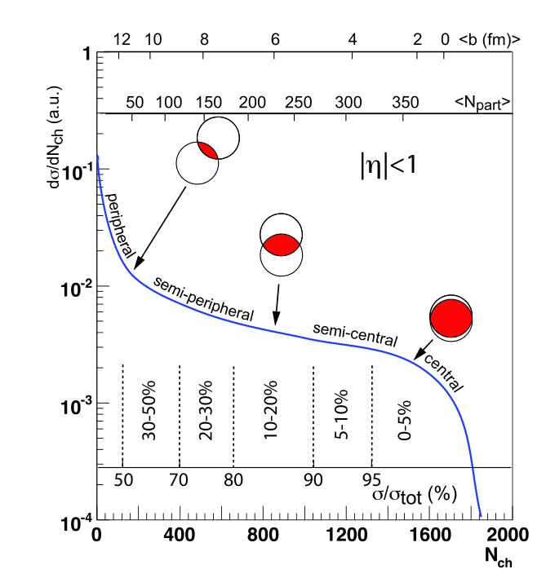
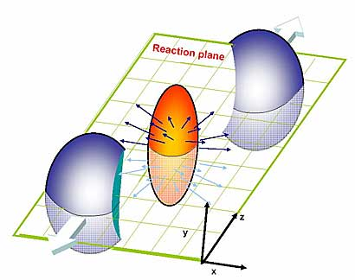
The Glauber Model
The Glauber Model is used to understand geometrical aspects of a heavy-ion collision
Assumes
Nucleons are distributed independently in the nucleus
Nucleons interact with other nucleons, but are undeflected

Slide 27
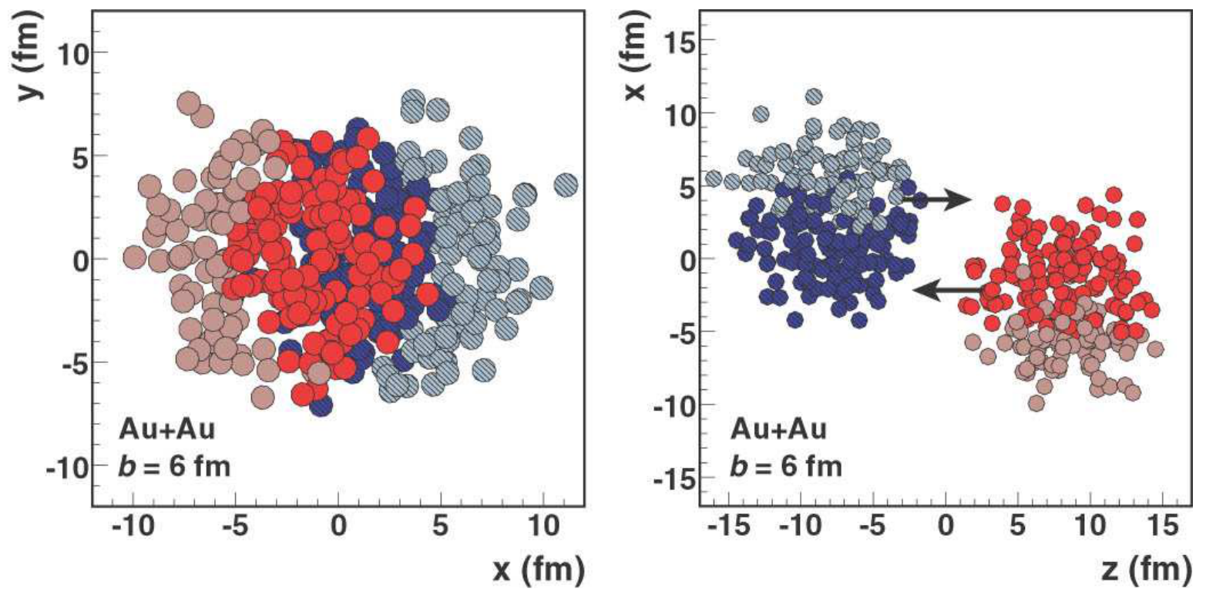
The Glauber Model continued
Overlap region
Spectators
Impact Parameter
Participants

Slide 28
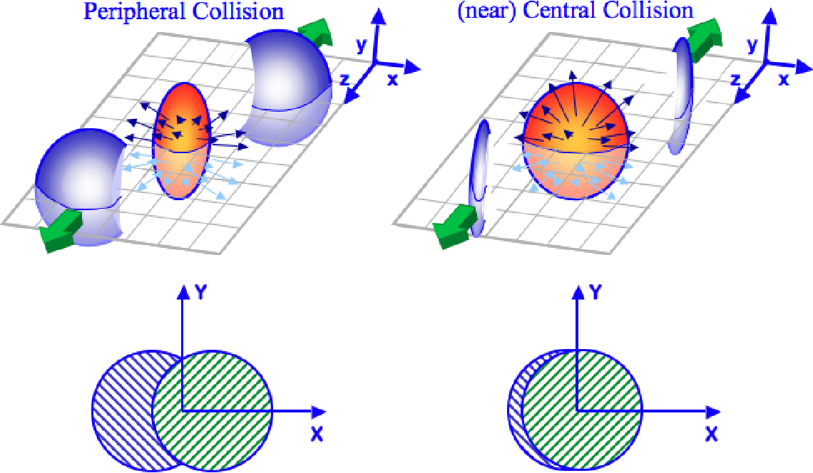
Glauber model implications
Q: How to know what type of collision occurred?
These two scenarios are very different!
https://www.semanticscholar.org/paper/Two-Particle-Correlations-And-The-Ridge-In-Heavy-Moschelli

Slide 29
Centrality
One talks about how central a collision is
The more the two nuclei overlap, the more central

Slide 30
Centrality determination
Unfortunately, experimentalists can not choose how the two nuclei collide
We must infer this from the particles in the detector
More particles produced → more overlap
Miller et al. 2007, nucl-ex/0701025

Slide 31
Collective Flow

Slide 32
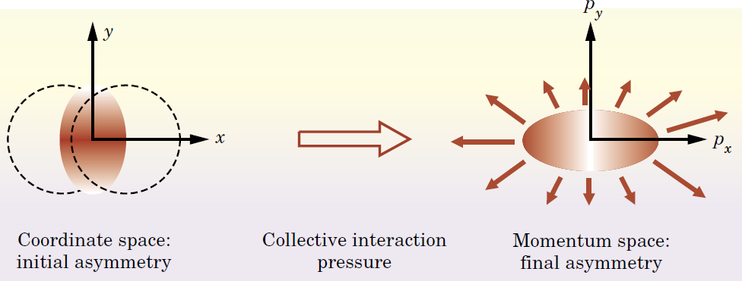
Collective Flow
Non symmetric angular shape initially
Non symmetric final state (but in momentum, no position)

Slide 33
Important Contributions from RSA
BSc from University of Venda
MSc from University of Cape Town
Currently Dean of Science at Nelson Mandela University
Azwinndini Muronga

Slide 34
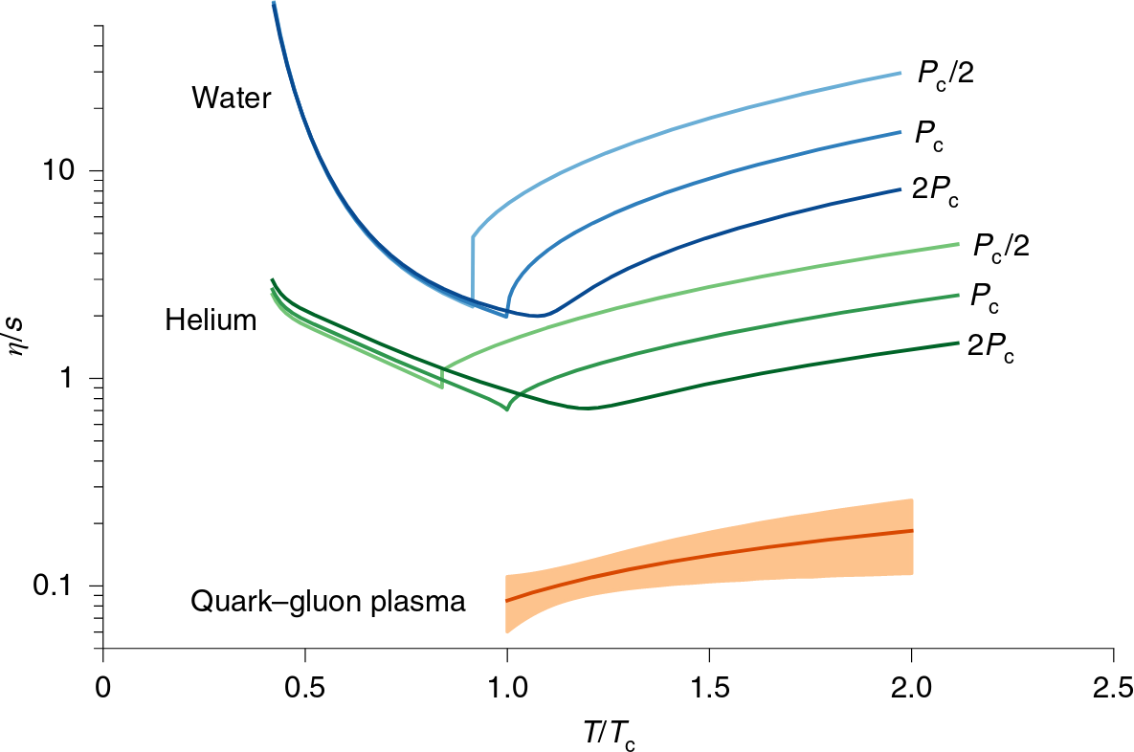
Creation of the Most Perfect Fluid
Smallest viscosity of any known fluid!

Slide 35
Quantifying signatures
So far we’ve talked about qualitative results
In physics, we want quantitative predictions
Introduce observables
Specific quantities that experiments can measure

Slide 36
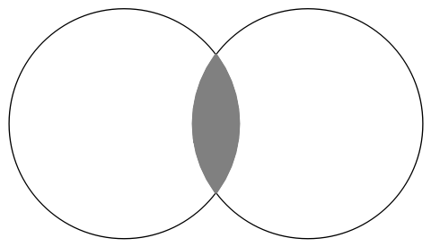
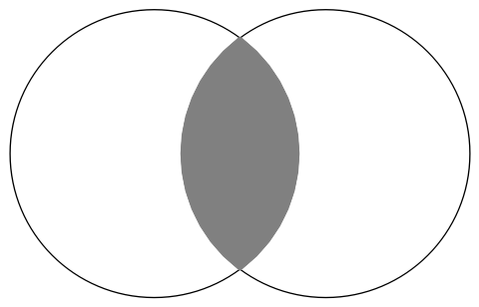
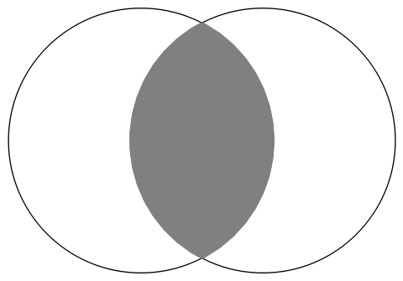
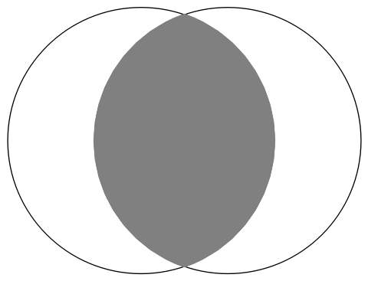
v2
The v₂ captures the ellipticity of the collision
v₂ is the Fourier coefficient of cos(2 φ)
Very elliptic
Less elliptic

Slide 37
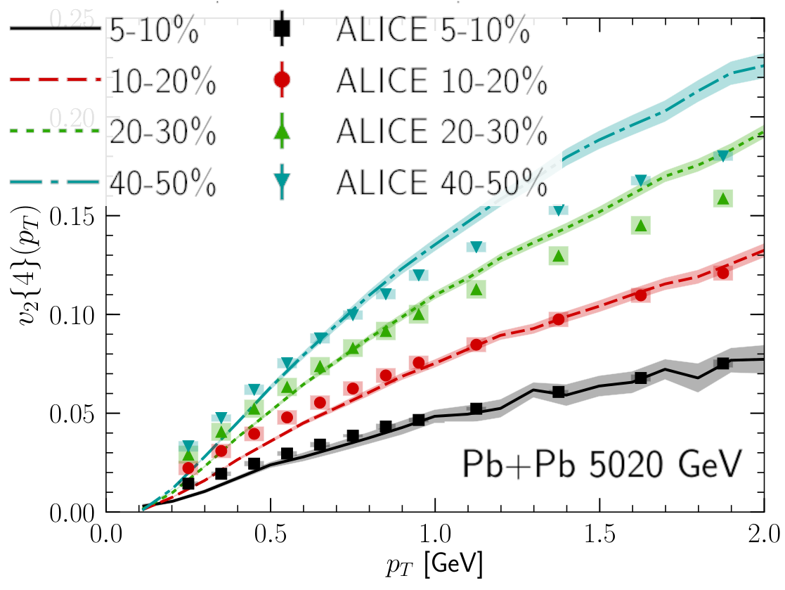
Quantitative Comparison to Data
Hydrodynamics models describe data
Centrality increasing
More elliptic, more flow
Schenke et al., Phys. Rev. C 102 (2020) 044905
Elliptical overlap region → angular anisotropy!

Slide 38
Jet Quenching

Slide 39
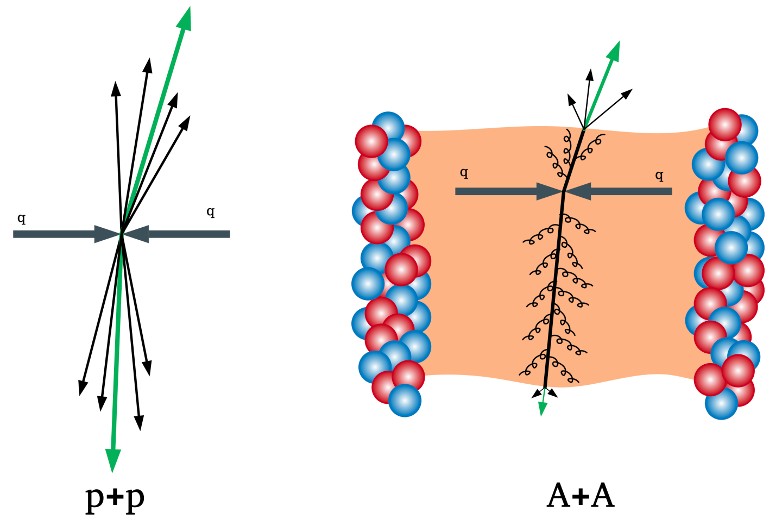
Energy loss
As quarks and gluons move through the plasma, they lose energy
https://atlas.cern/Updates/Feature/Heavy-Ion-Physics

Slide 40
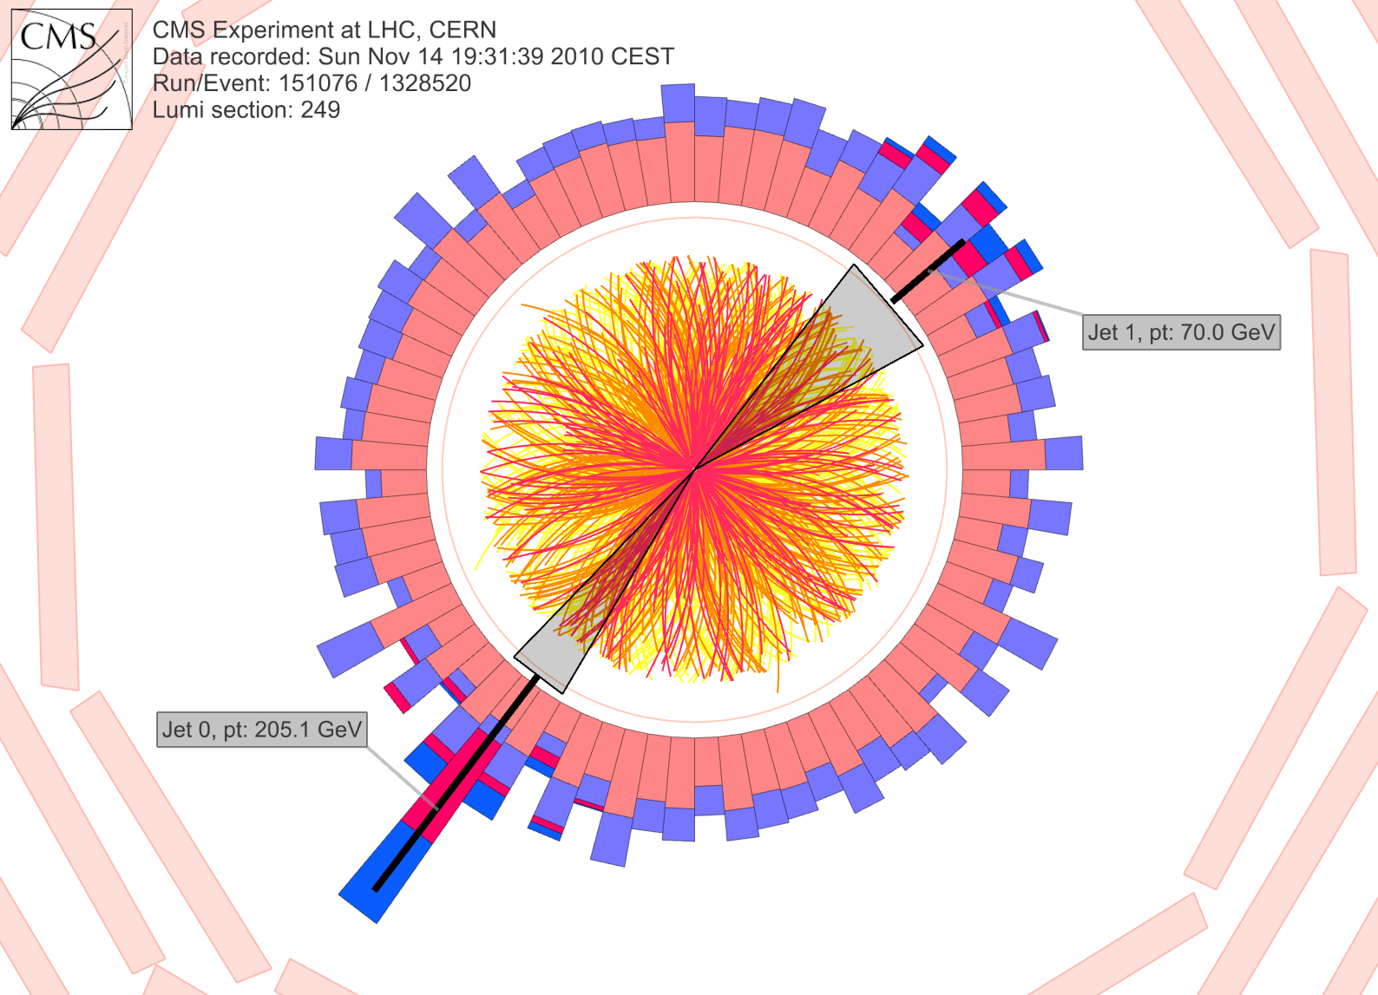
Seeing energy loss
Energy = 70GeV
Where did the energy go? A: Dissipated into the QGP!
Energy = 200GeV
https://cms.cern/news/jet-quenching-observed-cms-heavy-ion-collisions

Slide 41
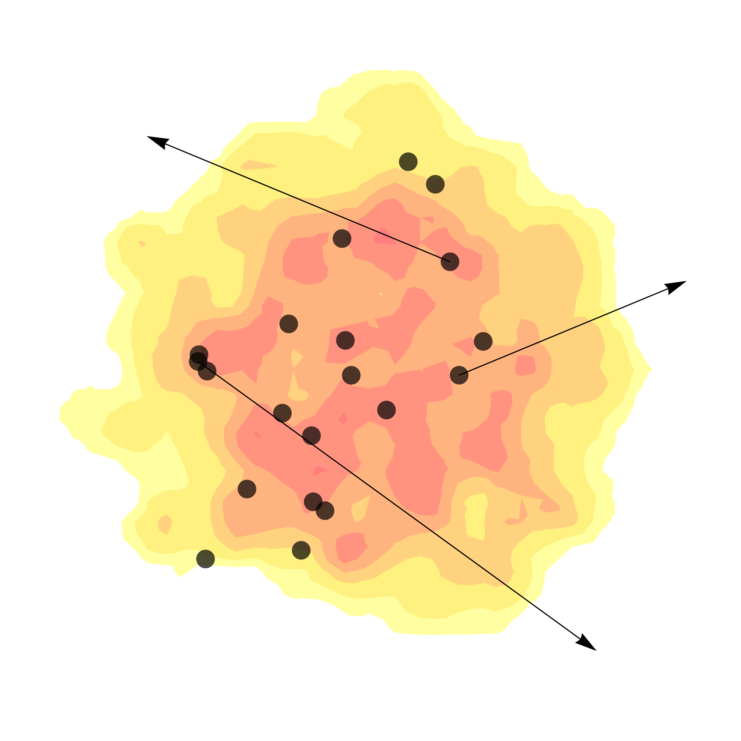
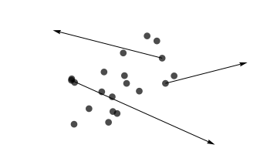
Nuclear Modification Factor
Again, we need to go quantitative
Glauber model is back!
Quantifies how much energy is lost in the medium

Slide 42
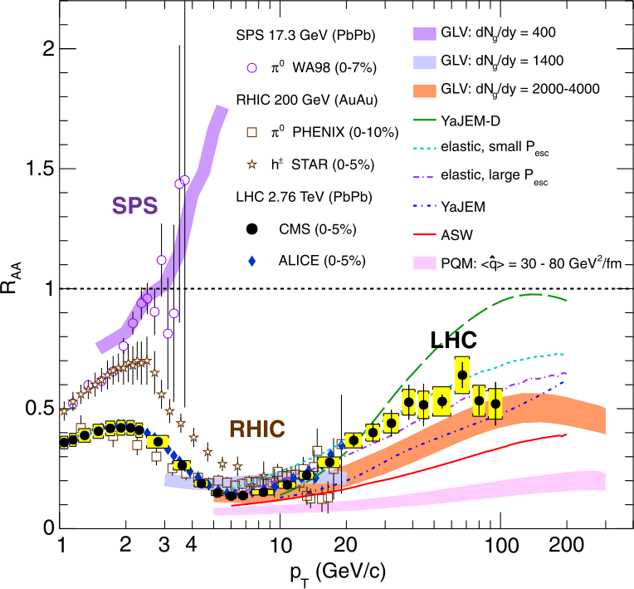
Experimental confirmation
RAA < 1 indicates energy loss
Models predict energy loss!

Slide 43
Strangeness Enhancement

Slide 44
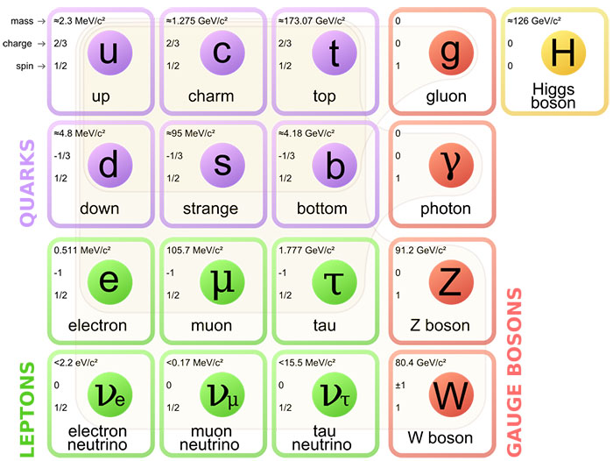
Strangeness enhancement
There are more strange quarks produced in a QGP
Protons and neutrons made from ups and downs => no strange before the collision

Slide 45
Why is there extra strange?
Strange quark mass ~ 100 MeV ~ temperature of Quark Gluon Plasma
Extra energy from the temperature allows strange quarks to be produced thermally

Slide 46
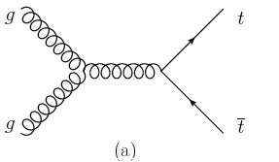
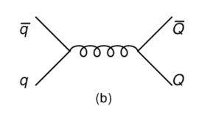
How are strange quarks made?
g + g → s + sbar
Other particles in the QGP can undergo interactions which make strange quarks
q + qbar → s + sbar

Slide 47
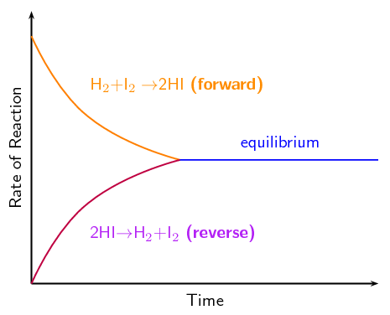
Just like chemistry!
Or g + g → s + sbar
Some sort of equilibrium of strange quarks in the plasma will be reached
Or s + sbar → g + g
Siyavula https://www.siyavula.com/read/za/physical-sciences/grade-12/chemical-equilibrium/08-chemical-equilibrium-01

Slide 48
Compared to what?
More strangeness in heavy ion collisions, compared to what?
Glauber model is back again!

Slide 49
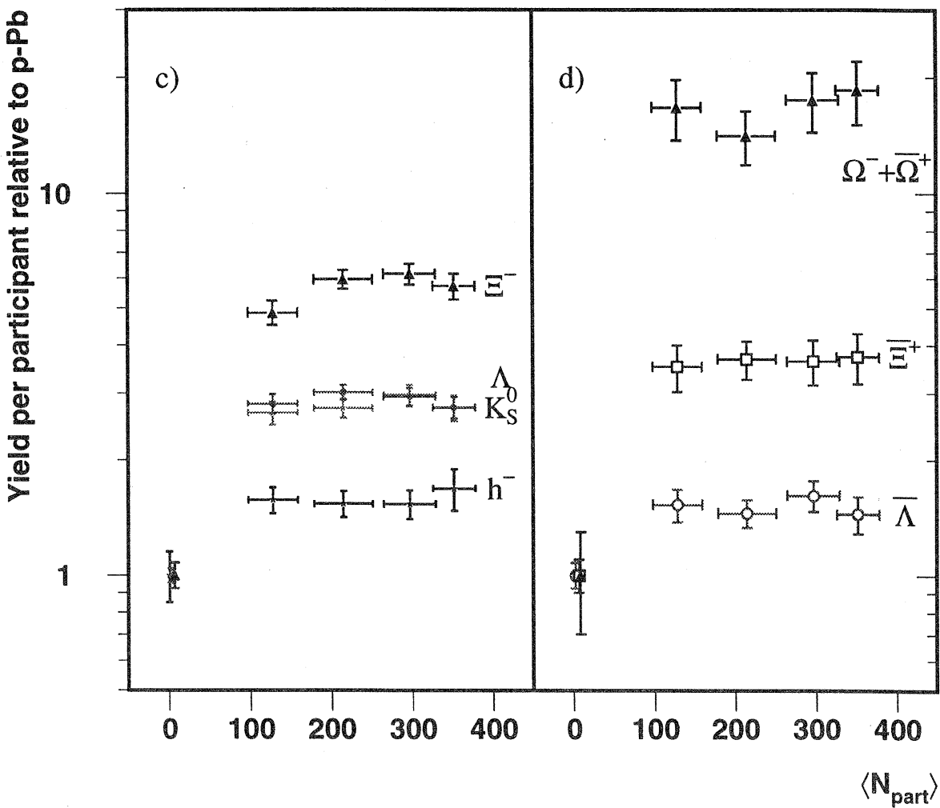
Experimental observation
(R from earlier)
s s s
The more strange, the more we see!
u s s
u d s
WA97 1999, PLB 449 401

Slide 50
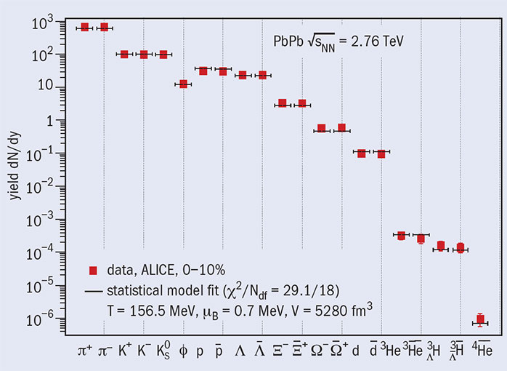
Detailed Model Comparison
Present day:
Statistical models can reproduce all numbers of various particles

Slide 51
How to study this!
Apply for physics honours at UCT
MSc with ALICE or in theory (UCT, etc.)
Opportunities for scholarships with SA-CERN
Trips to CERN, conferences, etc.

